Slide 2
Risk
A probability or threat of damage, injury, liability, loss, or any other negative occurrence that is caused by external or internal vulnerabilities, and that may be avoided through pre-emptive action.
Likelihood * impact

Slide 3
Risk Identification
Risk identification is the process of determining risks that could potentially prevent the program, enterprise, or investment from achieving its objectives.

Slide 4
Risk Analysis
requires an entity to, conduct an accurate and thorough assessment of the potential risks and vulnerabilities to the confidentiality, integrity, and availability of electronic protected information held by the entity.
Risk analysis, which is a tool for risk management, is a method of identifying vulnerabilities and threats, and assessing the possible damage to determine where to implement security safeguards

Slide 5
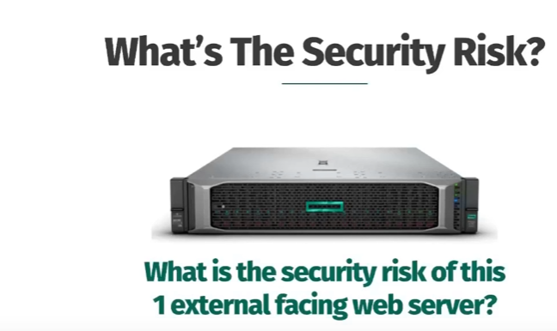

Slide 6
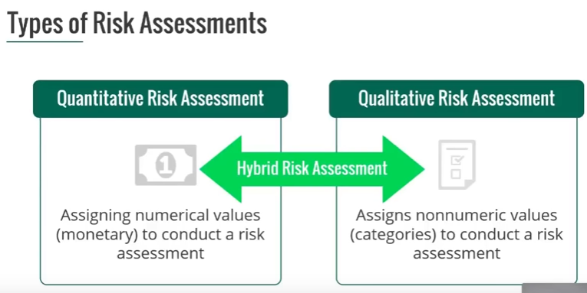

Slide 7
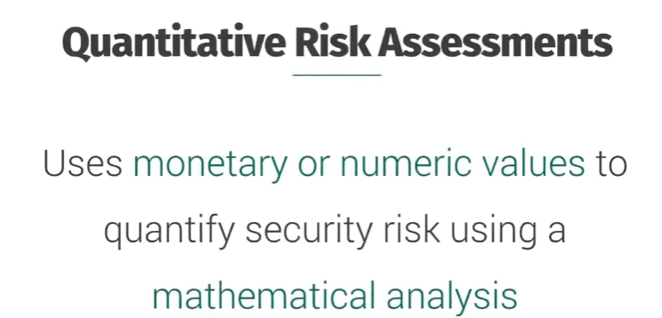

Slide 8
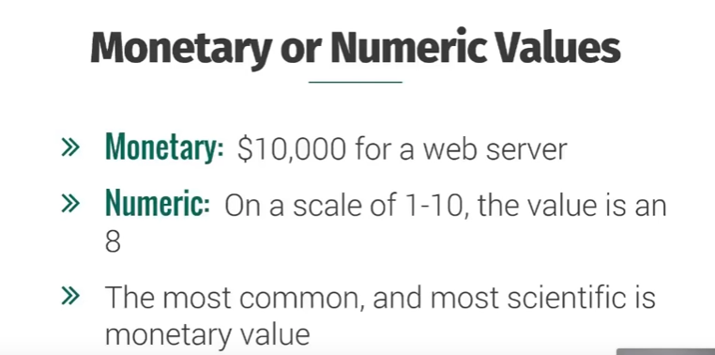

Slide 9
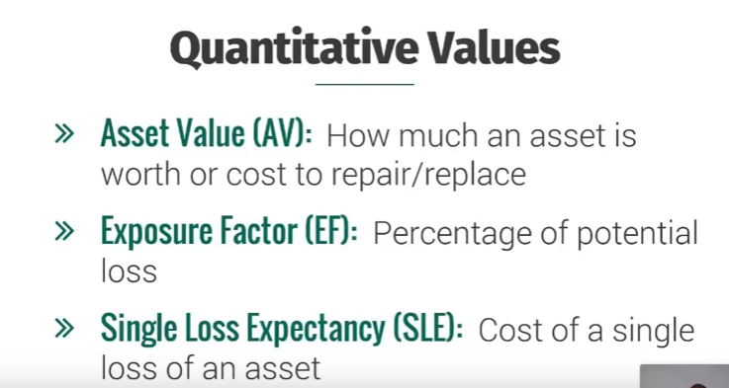

Slide 10
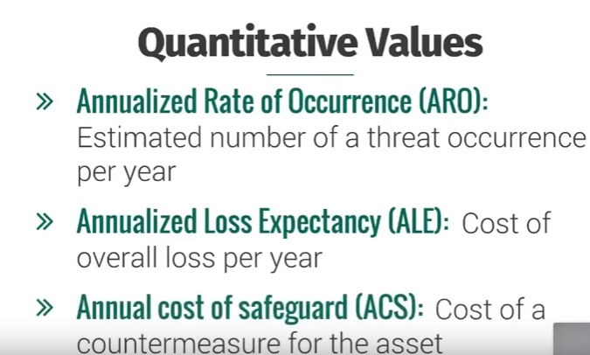

Slide 11
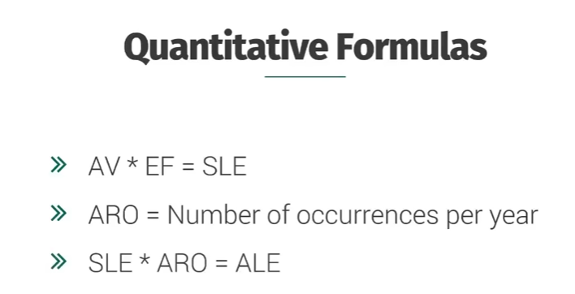

Slide 12
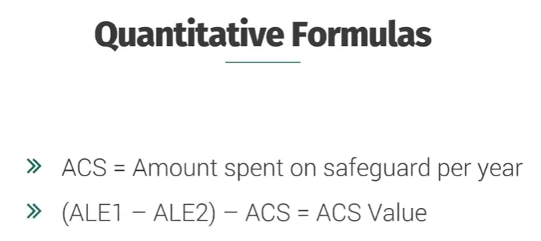

Slide 13
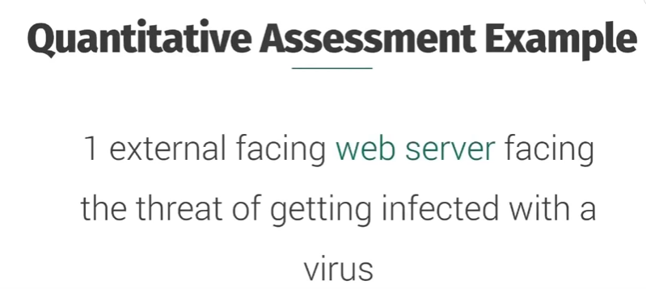

Slide 14
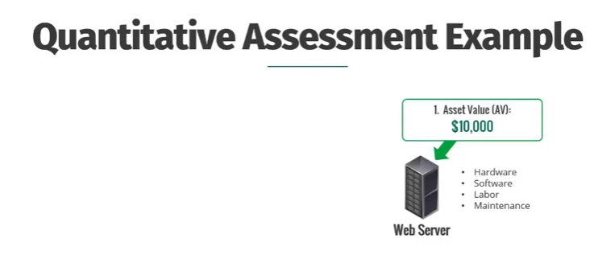

Slide 15
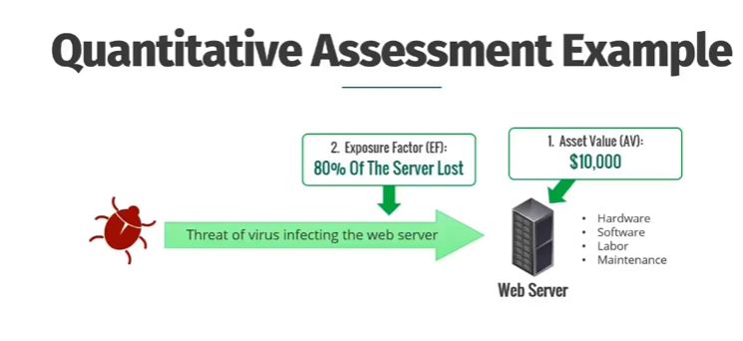

Slide 16
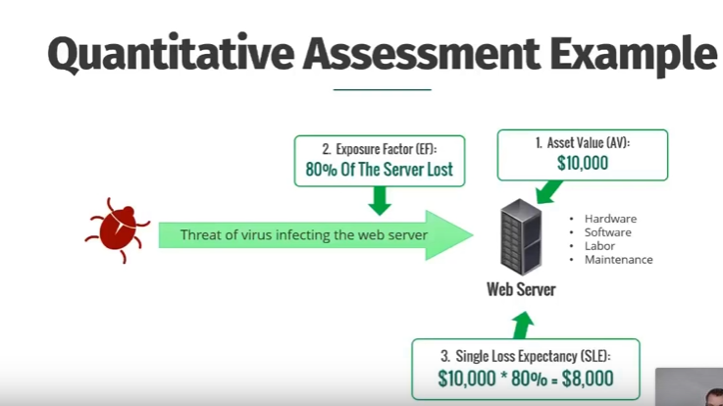

Slide 17
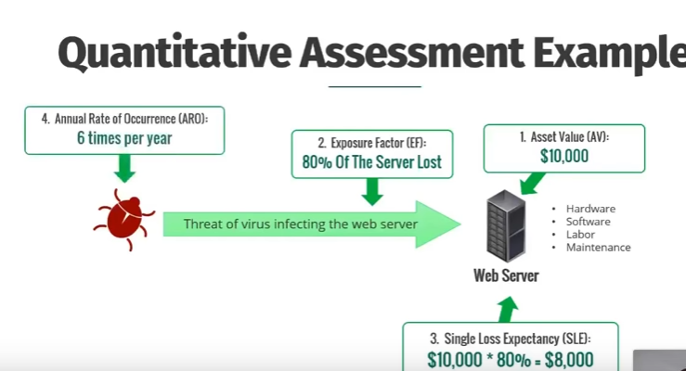

Slide 18
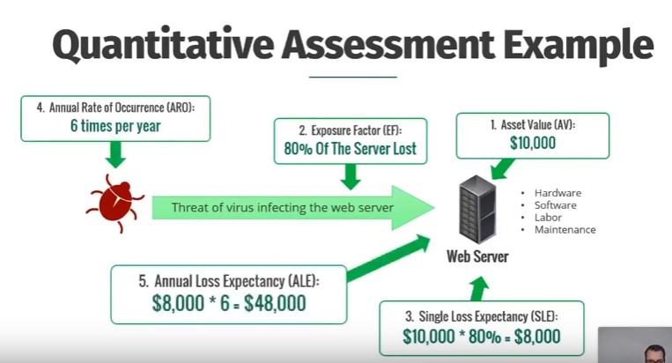

Slide 19
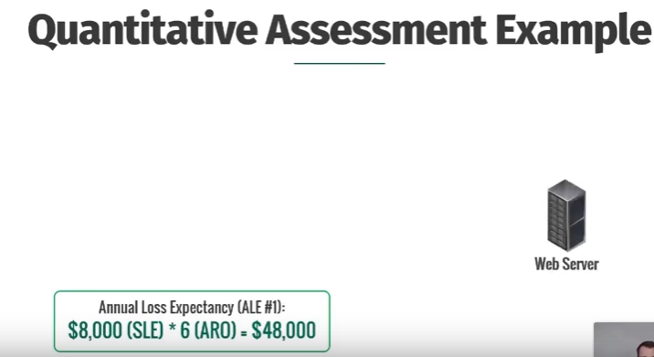

Slide 20
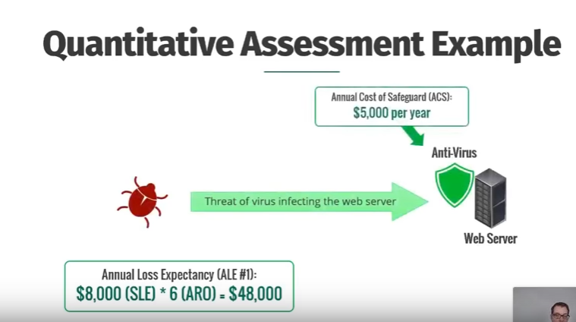

Slide 21
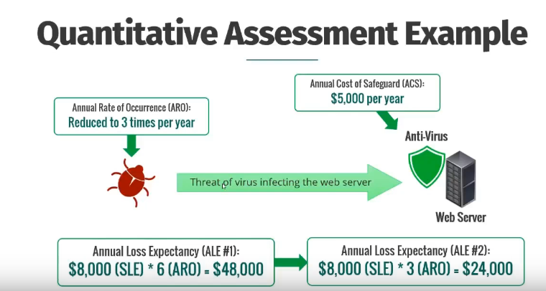

Slide 22
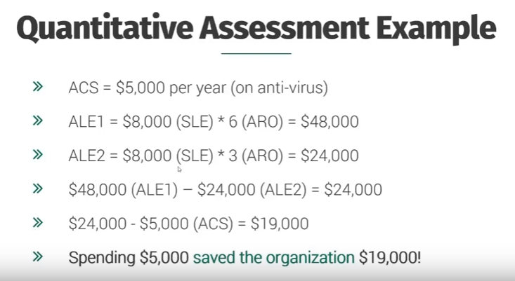

Slide 23
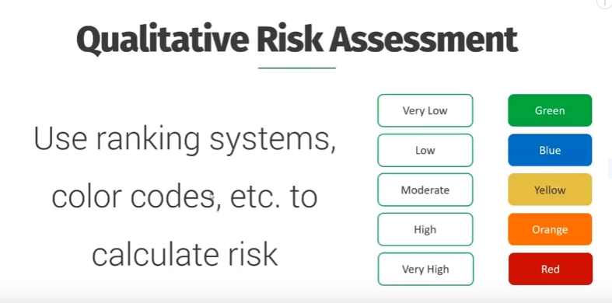

Slide 24
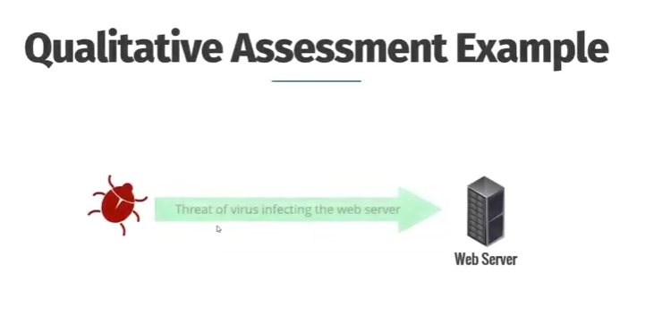

Slide 25
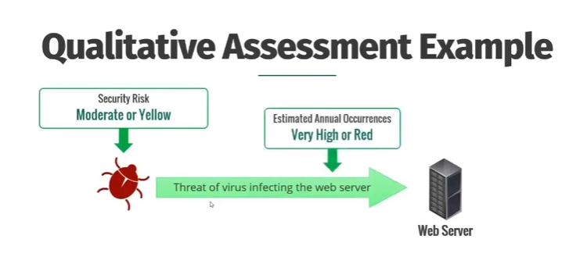

Slide 26
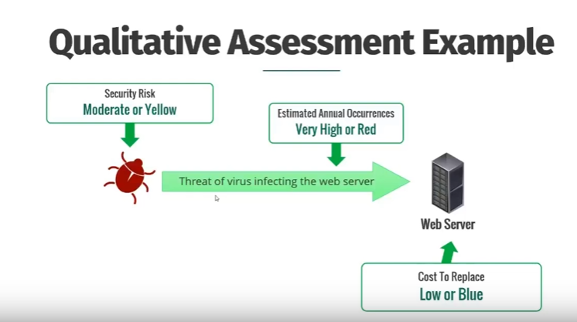

Slide 27
